Slide 1
Props
Props stands for properties.
They are inputs to a React component.
Props allow you to pass data from a parent component to a child component.
They are read-only (immutable inside the child component).

Slide 2
Why Do We Need Props?
To make components reusable and dynamic.
Instead of hardcoding values, we pass data via props.

Slide 3
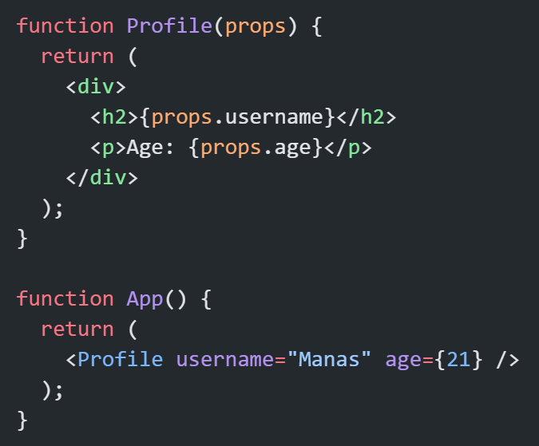
Basic Understanding

Slide 4
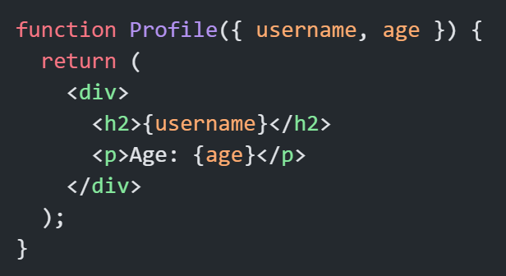
Destructuring Props (Cleaner Way)

Slide 5
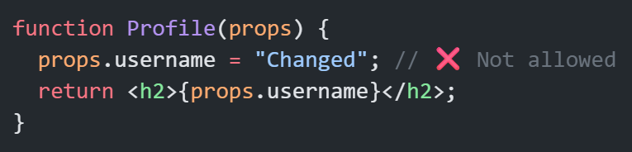
Props Are Immutable
You cannot modify props inside a child component.

Slide 6
All Possibilities of Props in React

Slide 7
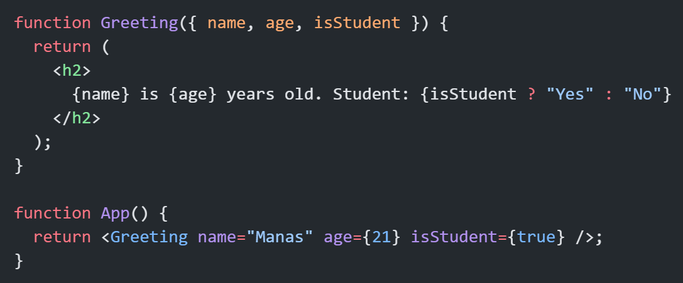
1. Basic Props (Strings, Numbers, Booleans)

Slide 8
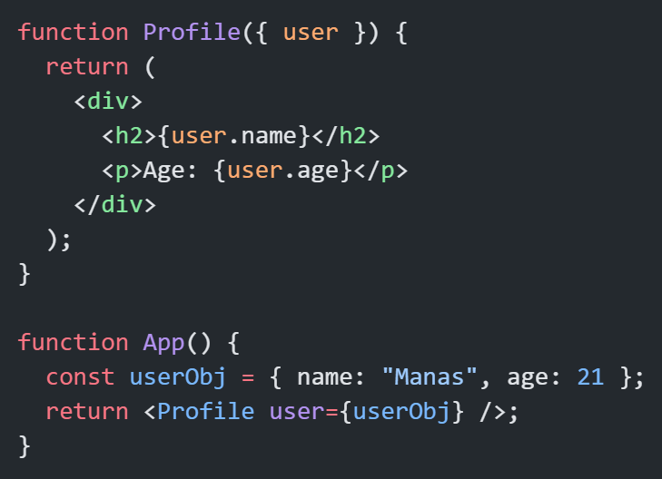
2. Props as Objects

Slide 9
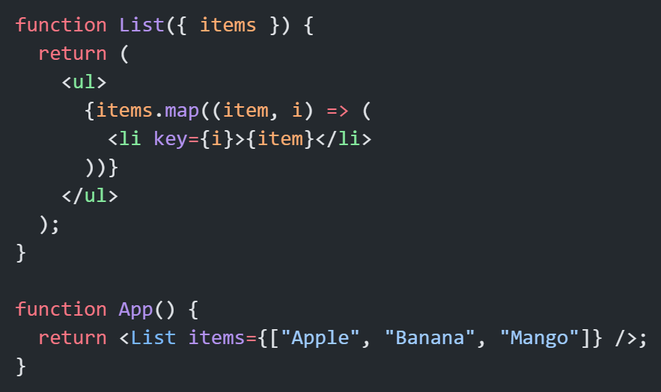
3. Props as Arrays

Slide 10
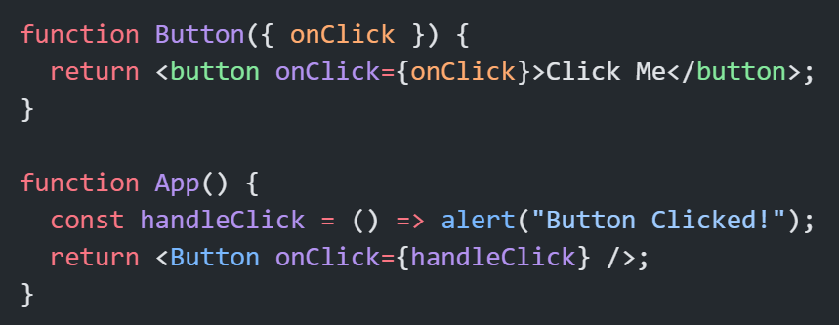
4. Props as Functions (Callback Functions)
Used for event handling or passing logic.

Slide 11
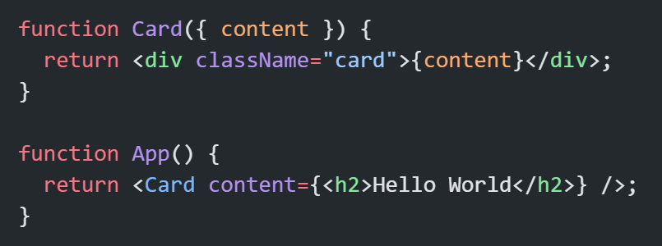
5. Props as JSX Elements
Passing React elements.

Slide 12
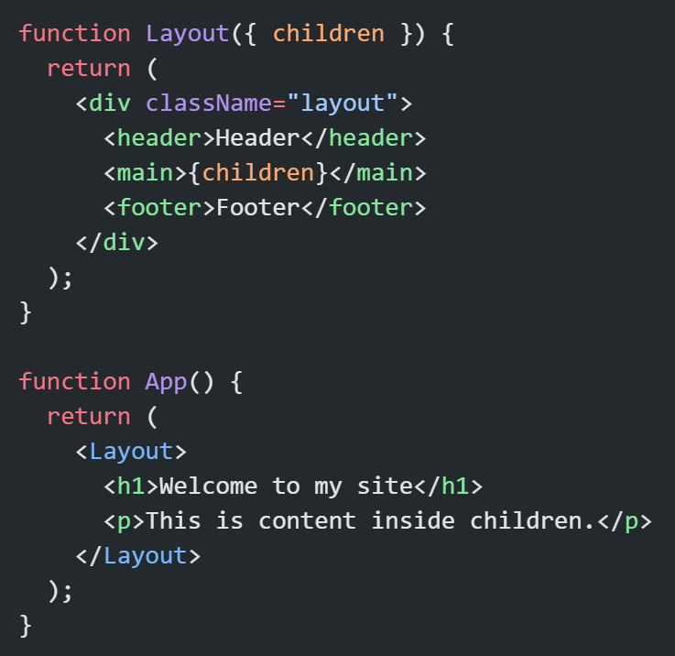
6. Props as Children (Special Prop)
Anything between component tags becomes props.children.

Slide 13
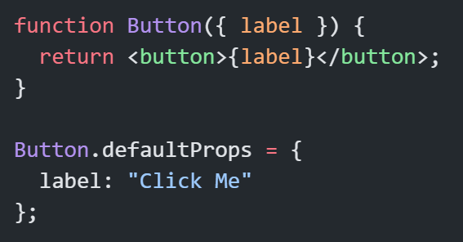
Default Props
You can define default values if a prop is not passed.

Slide 14
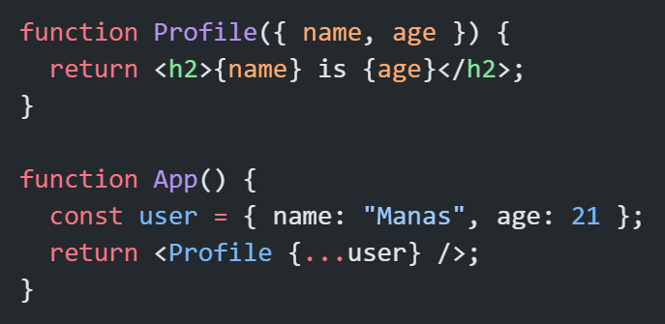
9. Spread Operator for Props
Pass all props at once.

Slide 15
Thank You

